Slide 1
Intro to Linux

Slide 2
Linux is Everywhere
Linux is everywhere
Linux jobs are everywhere
Linux skills are in demand in just about every industry and job category

Slide 3
Fun Facts
54.2% of the most powerful supercomputers operated on Linux in 2020.
90% of public cloud workloads are run on Linux.
Android constitutes 71.93% of the operating system market share.
Linux makes up only 1.30% of the desktop market share.
83.1% of professional developers agree Linux is the most loved platform.
59% of Ubuntu users prefer the English language.
In 2021, the Linux kernel counts 27.8 million lines of code.
Linux games on Steam account for 50,361.
Source: https://writersblocklive.com/blog/linux-statistics/

Slide 4
Linux is a Kernel
Linux kernel is the central controller of everything that happens on the computer, it is a core of the Linux operating system
Linux is a combination of software called GNU/Linux
The GNU Project was announced by Richard Stallman in 1983
GNU is the free software that provides open source equivalents of many common UNIX commands
The goal of GNU Project is to give computer users freedom and control in their use of their computers and computing devices by collaboratively developing and publishing software that gives everyone the rights to freely run the software, copy and distribute it, study it, and modify it

Slide 5
Kernel
Kernel manages the hardware and software:
Decides which program gets which blocks of memory
Applications make requests to the kernel and in return receive resources, such as memory, CPU, and disk space
Starts and kills applications, processes
A process is a task that is loaded and tracked by the kernel
An application may need multiple processes to function and kernel takes care of running the processes
Kernel starts and stops processes as requested
Handles the switching of applications - multitasking
Handles displaying text or graphics on a monitor
Etc...

Slide 6
Open Source
Most software is developed under a closed-source license
This means that you have the right to use the executable program or machine code, but cannot see the source code.
The open source philosophy is that you have a right to obtain the software source code and to modify it for your own use

Slide 7
History of Linux
The story of Linux begins with UNIX which is an operating system developed at AT&T Bell Labs in the 1970s
Linux development started in 1991 as a hobby project by Linus Torvalds
Linus Torvalds is a Finnish-American software engineer and he is the creator and the main developer of the Linux kernel
Linux programmers were able to incorporate the GNU tools to provide a complete operating system

Slide 8
Linux Distributions
A distribution is the collection of software that is bundled together:
Linux kernel
GNU tools
Suite of applications
Package Manager
Installer
Take Linux kernel, add the GNU tools as well as some productivity applications like a web browser, email client, and you have a Linux distribution
There are distributions suited to every imaginable purpose (use case)
There are distributions that focus on powering:
servers, desktops, special purpose hardware and etc.

Slide 9
GUI and CLI
There are two basic types of interfaces available that allow you to interact with the operating system:
The graphical user interface (GUI)
In a GUI, windows that can be resized and moved around are used to present applications
Menus and other tools to help users navigate the GUI interface
The command line interface (CLI)
a text-based interface
The CLI relies on keyboard for input

Slide 10
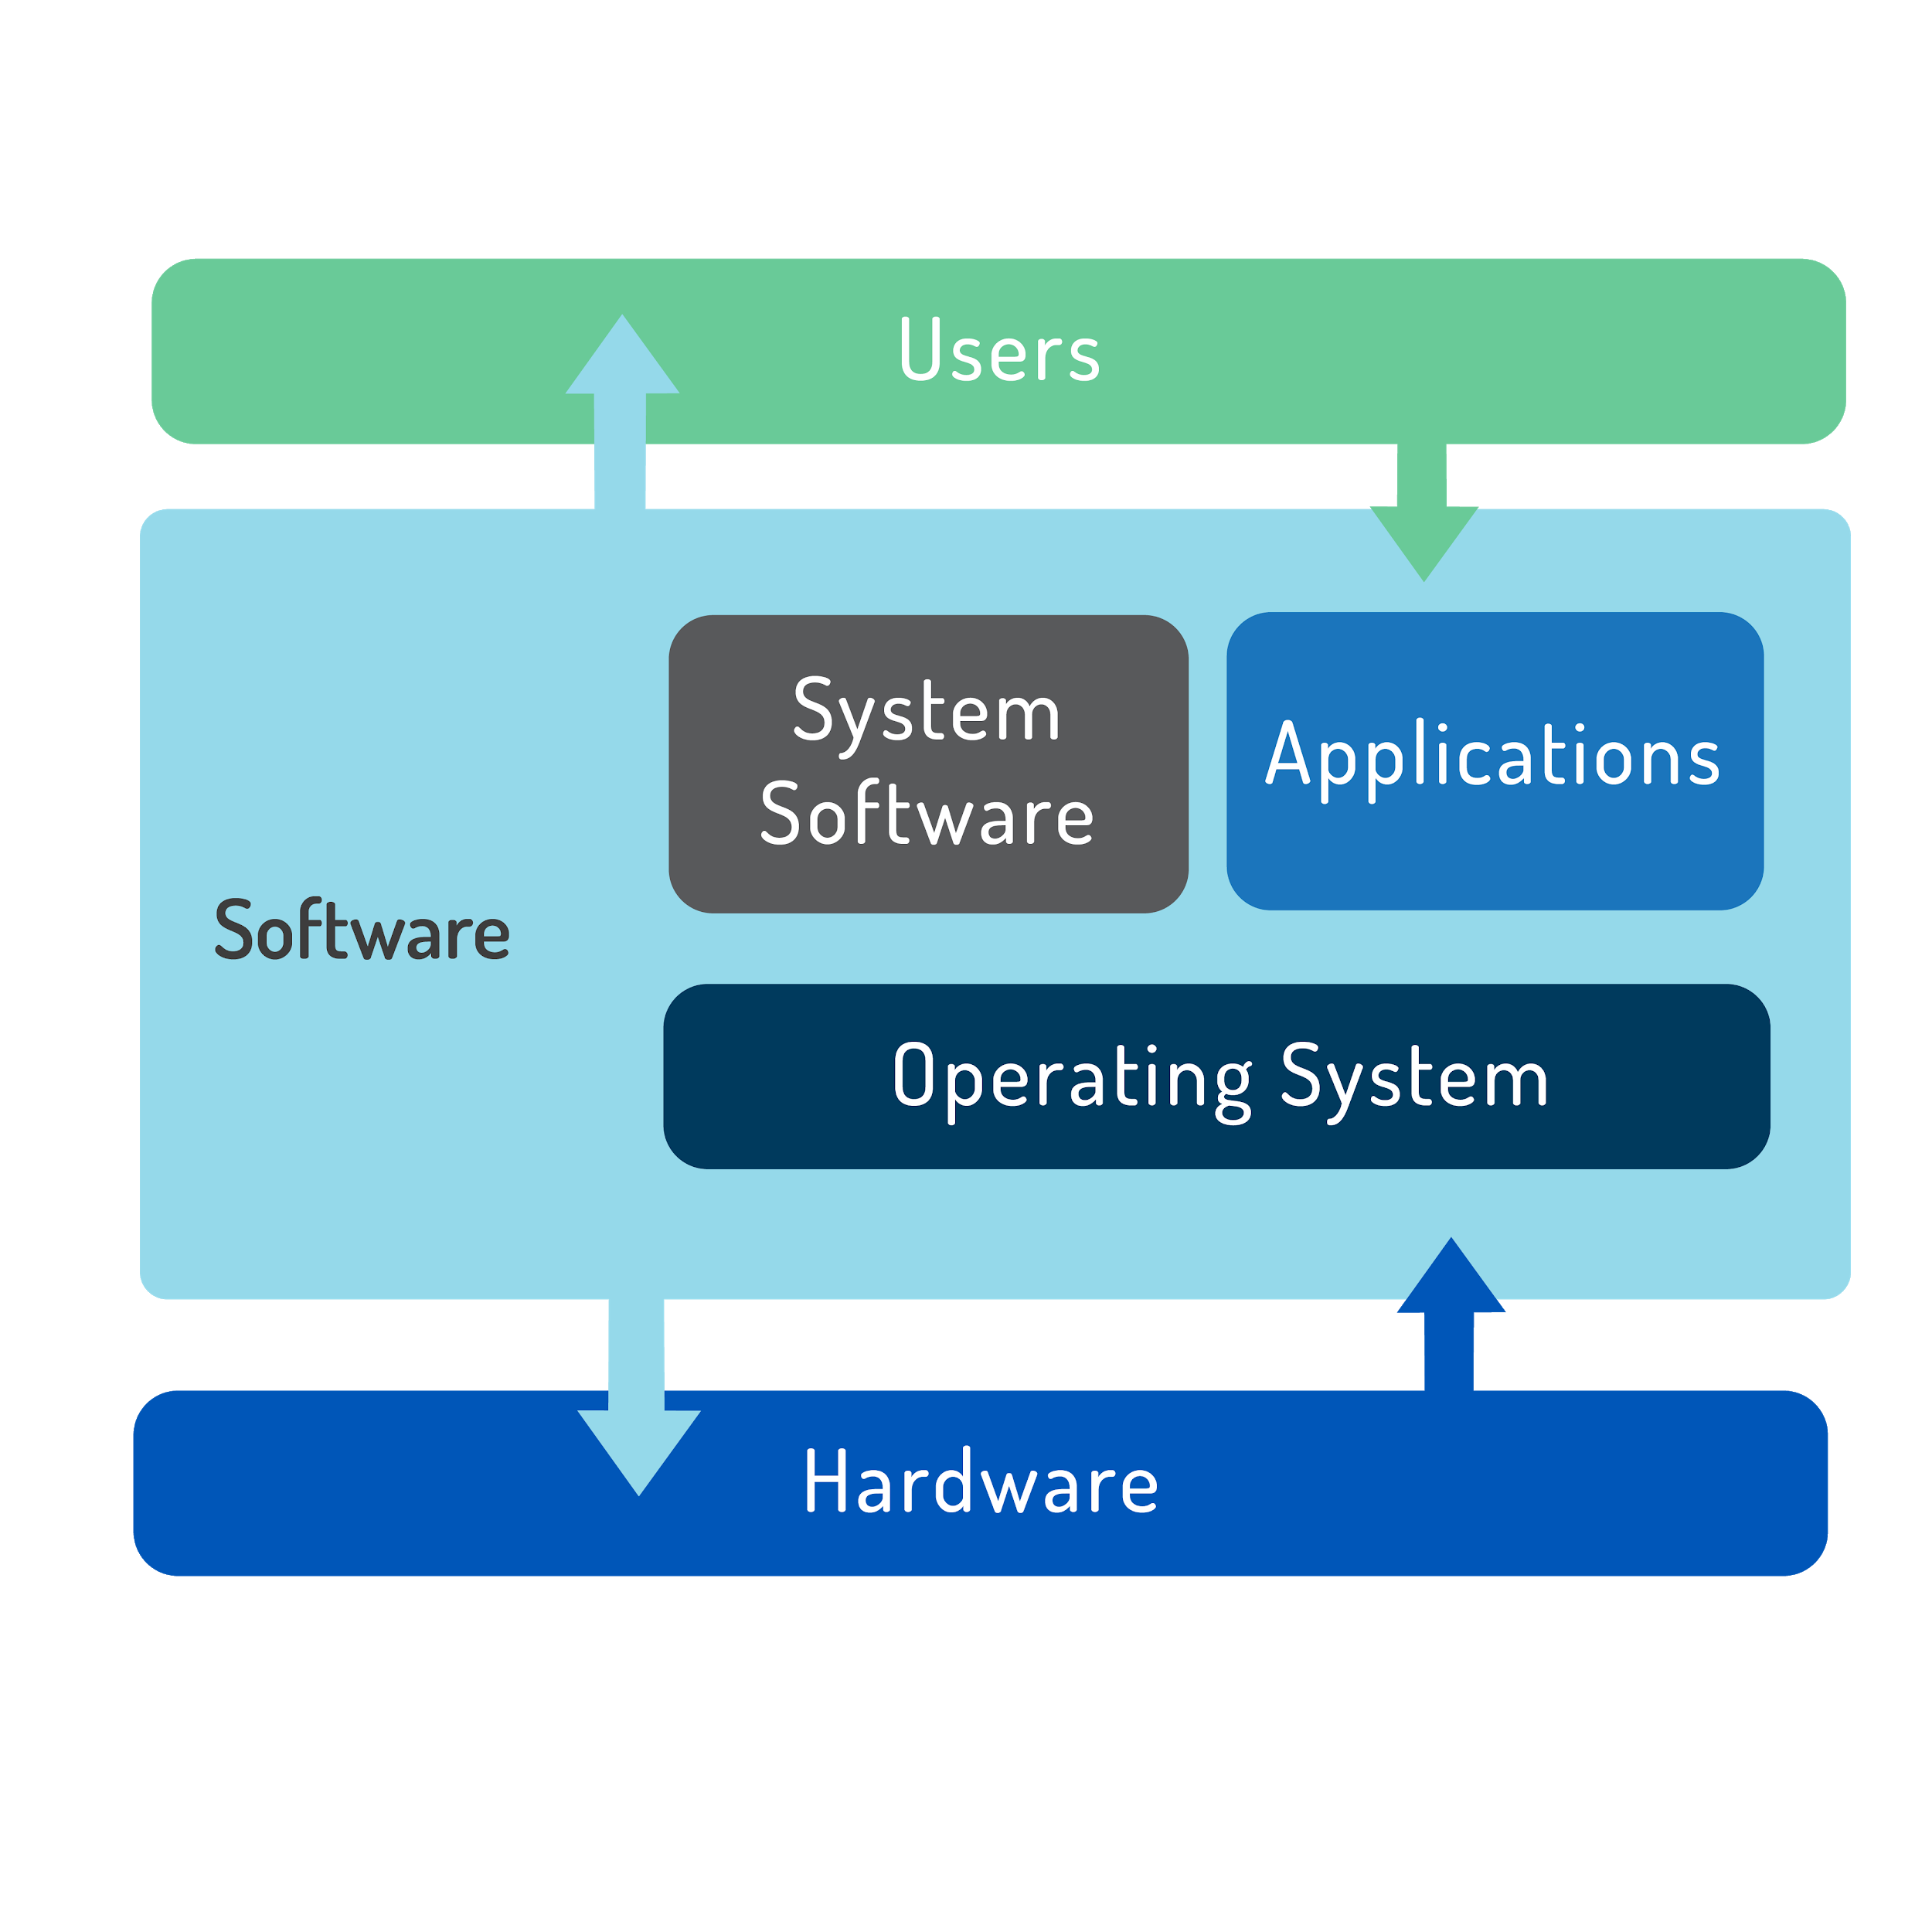
Operating System - OS
OS is software that runs on a computing device and manages the hardware and software components
OS also schedules applications to run and provides services to users

Slide 11
Operating Systems
There are three major operating systems:
Microsoft Windows
Apple macOS
Linux
Only Microsoft Windows is a proprietary OS that is based on code that is not Unix or Linux based

Slide 12
Microsoft Windows
Offers both desktop and server versions
Slow release cycle (3-5 years)
Long maintenance cycle
Emphasis on backward compatibility
Runs a Graphical User Interface (GUI) and there are CLI versions as well

Slide 13
Apple Mac OS
Runs on Apple hardware
Server version adds packages to the desktop version to aid in management and sharing
UNIX certified
New major releases every 18-24 months

Slide 14
Linux
To use Linux you must choose a distribution
Different distributions focus on different use cases:
desktop, server, scientific, network, special purpose, and etc.
Some distributions offer commercial support, most is volunteer based
Visit: https://www.DistroWatch.com

Slide 15
Choosing Linux
Role:
Distributions available for variety of different systems:
commercial for servers, community editions for desktops and laptops, specialized computer computers, embedded systems, and etc.
Function:
Distributions can be chosen based on of usage, features, or security needed, and etc.
Life Cycle:
Distributions have major and minor update cycles
Some distributions have long-term support, LTS, 5+ years or 13yrs for SUSE LTS
Stability:
Distributions offer stable, testing, and unstable releases
Support:
Distributions themselves are free
Enterprise users can pay for support or attempt self-support

Slide 16
Major Linux Distros – Red Hat
Focus is on server applications like web and file server
Red Hat Enterprise Linux (RHEL) – commercial and stable distribution with long release cycles
Sponsors the Fedora Project – free and open source personal desktop OS with latest software
CentOS is a Linux distribution that provides a free and open-source community-supported computing platform, functionally compatible with its upstream source, Red Hat Enterprise Linux
Scientific Linux a free and open-source operating system based on Red Hat Enterprise Linux. This distribution is derived from the free and open-source software made available by Red Hat, but is not produced, maintained or supported by them

Slide 17
Major Linux Distros – SUSE
One of the first distributions which is derived from Slackware
Contains proprietary code and is sold as a server product
Some modules or addons may contain proprietary code
Sold as a server product
Workstation version are also available
OpenSUSE is an open source and free version with multiple desktop packages

Slide 18
Major Linux Distros – Debian
Debian is a community effort that promotes use of open source software
Ubuntu is its most popular derived distribution
Ubuntu has desktop and server versions
Ubuntu also offers an LTS version
Linux Mint is a derivative of Ubuntu with various free versions, some have license restrictions

Slide 19
Linux Kernel Based OS - Android
Android is a platform for mobile users
Android does not have traditional GNU/Linux packages and cannot run on desktop
Sponsored by Google

Slide 20
Other Linux Distributions
There are many other Linux distributions
Raspbian is a Linux distribution designed to run on Raspberry Pi hardware
Linux From Scratch (LFS) consists of an online book, source code, and instructions for building a custom Linux distribution
And many more – check https://www.DistroWatch.com
Some distributions can be used as learning tools

Slide 21
Major Applications
Software generally falls into one of three categories:
Server Applications: serve information to other computers, called clients
Desktop Applications: Web browsers, text editors, music players, or other applications used by users directly
Tools: Software that makes it easier to manage computer systems

Slide 22
Console/Terminal/Shell
The Linux system console
The system console is the device which receives all kernel messages and warnings and which allows logins in single user mode
The Linux console provides a way for the kernel and other processes to send text output to the user, and to receive text input from the user
The user typically enters text with a computer keyboard and reads the output text on a computer monitor
Terminal is a program that runs a Shell
Shell is a program which processes commands and shows output
Users interact with a Linux system through a shell, which accepts commands to execute
There are many Shells in Linux:
the Bourne shell, the C shell, the Bourne Again (Bash) shell, the tcsh, the Korn shell (Ksh), the zsh, and etc. ( https://en.wikipedia.org/wiki/Unix_shell )

Slide 23
Package Management
Package management allows to add, remove, and update software
Distributions use packages. Packages greatly simplify the installation of software
packages are compressed files that include:
Metadata
Application and it’s dependencies (or required files)
A package manager takes care of keeping track of which files belong to which package and even downloading updates from repositories
There are many different software package management systems
Two most popular are
Debian and Red Hat

Slide 24
Debian and RPM
Debian Package Management:
The Debian distribution and its derivatives such as Ubuntu and Mint, use the Debian package management system
Packages that are distributed as files ending in the .deb extension
Tools: dpkg, apt-get, aptitude, Synaptic, Software Center, and etc.
RPM (Red Hat Package Manager) Package Management:
Distributions derived from Red Hat, including Centos and Fedora, use RPM
Packages that are distributed as files ending in the .rpm extension
Tools: rpm, yum, up2date, zypper, and etc.

Slide 25
Open Source Philosophy
Users have the right to obtain the software source code and modify it for their own use
Software projects use source code:
a human-readable set of computer instructions

Slide 26
Open Source Licensing
Software Licensing define:
Ownership
Who owns the intellectual property?
Money Transfer
Does it cost anything?
How do you pay?
Licensing
What do you get?
What can you do with the software?
On how many computers can you run it?
Can you share the software?

Slide 27
Open Source Licensing
End User License Agreement (EULA)
legal document that must accepted before installing software
GNU General Public License version 2 (GPLv2)
license that states the source code must be made available to anyone and that anyone can make changes
changes must be under the same license
Free and Open Source Software
software where anyone can view source code, modify it, and redistribute it

Slide 28
Free Software Foundation - FSF
FSF was founded in 1985 with goal of promoting free software. Advocates for freedom to share, study, and modify the underlying source code
FSF enforces copyleft
the philosophy that if someone modifies free software, they are required to share those changes when they share the modified software
Developed their own licenses which are free and are based on GNU General Public License (GPL)
GPLv2, GPLv3, LGPLv2, and LGPLv3

Slide 29
Open Source Initiative - OSI
An open-source license is a type of license for computer software and other products that allows the source code, blueprint or design to be used, modified and/or shared under defined terms and conditions
List of Open Source Licenses:
https://opensource.org/licenses-draft
Licenses that are most widely-used:
Apache License 2.0 (Apache-2.0)
GNU General Public License version 3.0 (GPL-3.0)
BSD 2-Clause License (BSD-2-Clause) (called "Simplified BSD" or "FreeBSD")
MIT license (MIT)

Slide 30
FOSS/FLOSS
Free and Open Source Software (FOSS)
open source community, which consists of Free Software and Open Source as a collective (a catch-all term)
Free/Libre/Open Source Software (FLOSS)
uses the term libre to define the difference between free from restrictions (Libre) and free from cost (Free)

Slide 31
Creative Commons
Licenses without copyleft are called permissive
Attribution – Must acknowledge the author
ShareAlike – Copyleft
No-Derivs – You may not change the content
NonCommercial – No commercial use
Combinations are allowed
Attribution-No-Derivs-NonCommercial

